Slide 1




HackOrbit 2025
PitchPerfect

Slide 2








THEME & PROBLEM STATEMENT
Artificial Intelligence & Machine Learning
Audiences look for energy they face flatlines
Speakers demand clarity
they get chaos
Startups chase funding; they stumble in silence
Presenters seek confidence they get clutter
Teams want data; they’re stuck with opinions
Pitch
Perfect
Speakers today miss critical, real‑time insights on pacing, filler words, and emotional impact—relying on pricey, hit‑or‑miss coaching. Without actionable AI feedback, hidden flaws derail engagement, costing confidence—and opportunities.

Slide 3






PROPOSED SOLUTION
Capture & Sync
Composite Scoring
Prosody Analysis
High‑fidelity video/audio with timestamping
openSMILE extracts pitch, rhythm, energy
Weighted rubric for Clarity, Confidence, Charisma
Speech Based Anaylsis
NLP Insights
LLM Coaching
Whisper‑powered STT for 95%+ accuracy
Filler‑word density, sentiment flux detection
AI powered generation of contextual, timestamped tips

Slide 4
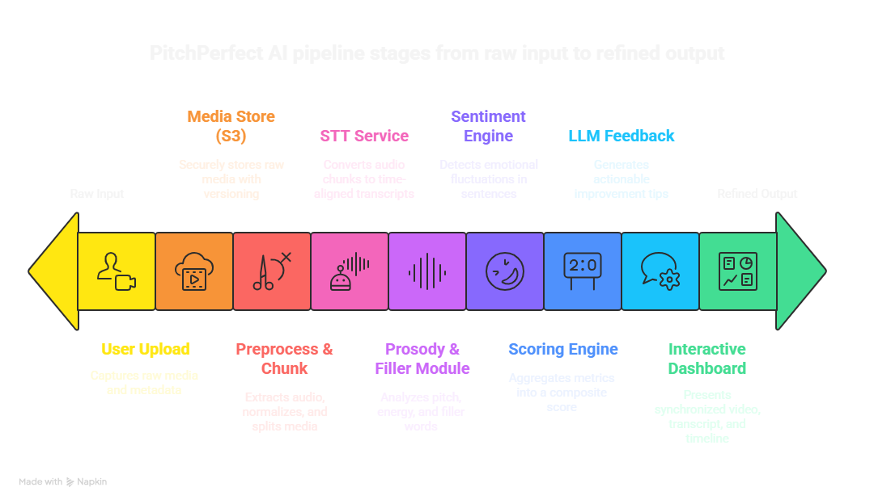
FLOWCHART / DIAGRAM
Raw Input

Slide 5
FLOWCHART / DIAGRAM
User uploads presentation (video/audio)
Stores raw media in S3
Preprocess: extract audio, normalize, chunk
STT service generates time‑aligned transcript
Prosody & filler module extracts pitch, rate, and filler counts
Sentiment engine analyzes emotional tone
Scoring engine computes composite 0–100 score
LLM feedback service crafts actionable, timestamped tips
Interactive dashboard visualizes video, transcript, and metrics

Slide 6

FEATURES AND NOVELTY
Interactive Dashboard
Transparent Scoring
Clear 0–100 rubric across Clarity, Confidence, Engagement
Turn your voice data into actionable tips and charts that guide your speaking improvement
Adaptive LLM Feedback
Personalized, timestamped coaching from GPT‑4
Deep Prosody Metrics
Continuous Learning
Advanced pitch variance & emotional contour analysis
Dynamic weighting adapts to user growth

Slide 7





DRAWBACK AND SHOWSTOPPERS
Data Privacy
Processing Latency
API Costs
Encrypted uploads & GDPR‑compliant pipelines
Optimize batch sizing; GPU acceleration
Appropriate usage caps, hybrid or self‑hosted options
Accent Bias
Integration Complexity
Multilingual model fine‑tuning; user‑driven retraining
Dockerized microservices; clear API contracts

Slide 8
PitchPerfect
Shah Dev Mineshkumar - shahdev10a13@gmail.com
9328424234
Patel Shreyansh Alpeshkumar - shreyanshpatel1826@gmail.com
7984086642
Savani Utsav Dhirajkumar - savaniutsav268@gmail.com
7859829058
Shah Meet Hirenkumar - meetshah170106@gmail.com
9974705637

Slide 9
Thank you

